Slide 1
Crash Detection

Slide 2
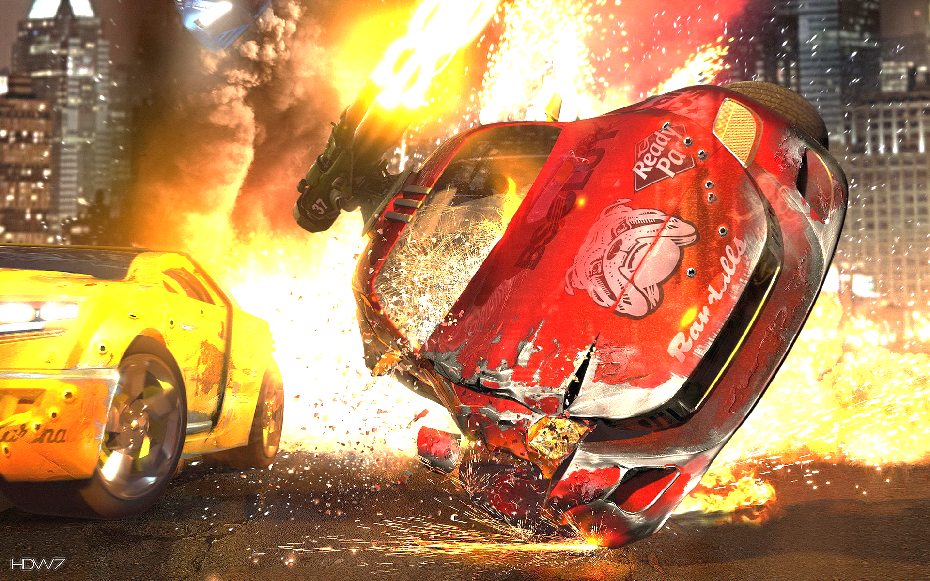
Problem Statement
There is an constant increase in the number of road fatalities all around the world. Despite the abundance of video feeds collected by millions of CCTVs scanning the roads every second, it is highly challenging for a human to monitor and alert the authorities in the case of emergencies.
Our aim is to uses the present resources and harness the power of Deep Learning to model an AI to detect accidents in video streams.

Slide 3
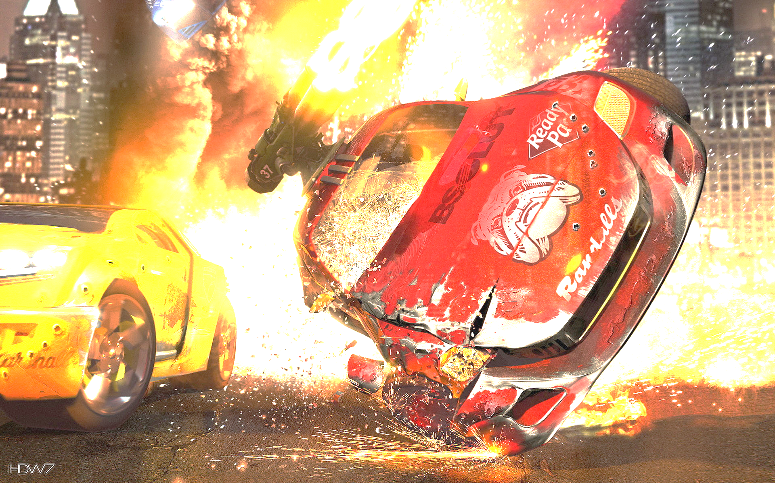
Challenges to overcome
DATA - Data hungry DL models require a lot of data in order to give us proper insites. There is a huge deficit in video and sequential data in the field. And rarely captured accidents are very hard to come by.
Model - We need to build a model which not only understands what is in an video but also how it varies over frames.

Slide 4
Dealing with the data problem
Invested a lot of time digging for CCTV footages and was able to get hands on quality feeds. Unfortunately, accidents were barely discovered in them.
Finding an alternative means we decided to go with dashcam videos. As drivers from countries like Taiwan, Russia are increasingly using dash cams as a proof for insurance companies, we were able to find few on the web.

Slide 5
Collecting the data
Found many videos and made a playlist in order to avoid duplicates.
As they were huge videos with only seconds of frames of interest, we had to find more efficient way to scrape these clips from them. Using manual tools is a time taking process and not really practical.
Compiled a bunch if scripts to extract the clips as efficiently as possible.

Slide 6
MILESTONE 1
Collected 200 videos containing a balanced proportions of accidents/positive and non-accident/negative videos using python scripts.

Slide 7
Processing the data
Helper functions to extract METADATA to get critical information of the collected videos
Flexible functions to preprocess the huge video data so that we pass the information to the model saving memory.

Slide 8
Object Detection using YOLOv2
Sometimes AI needs some help from the humans. We can try to show them the cars in the videos so it can be easier to understand what to look for.
Implemented state of art object detection YOLOv2 using python and fine tuned the model to detect larger number of vehicles in the frames.

Slide 9
MILESTONE 2
State of art object detection model for video data annotation.

Slide 10
Exploring models for sequential data
Studied a number of papers on sequential data like text and videos. Explored approaches in action recognition.

Slide 11
Analysis of related works
Implemented already existing models on video classification and accident anticipation.
Experimented with on the dataset we collected
Drew useful conclusions on how to approach the problem and the robustness of the dataset collected.

Slide 12
What’s going on now..
Doubling the dataset to cover much more diverse scenarios.
Experimenting much more complex models on video classification and processing like deep convnets and flow nets.
Exploring various cloud GPU services to run the number crunching algorithms.

